Slide 1
PLANNING AND
DECISION-MAKING
Essentials of Planning and Decision-Making

Slide 2



Slide 3
Planning…
The most fundamental and basic of all management function
Involves a rational approach in selecting and achieving goals and objectives and deciding on the actions to achieve them.
Strongly implies managerial innovation.
Bridges the gap from where we are and to where we want to go.

Slide 4
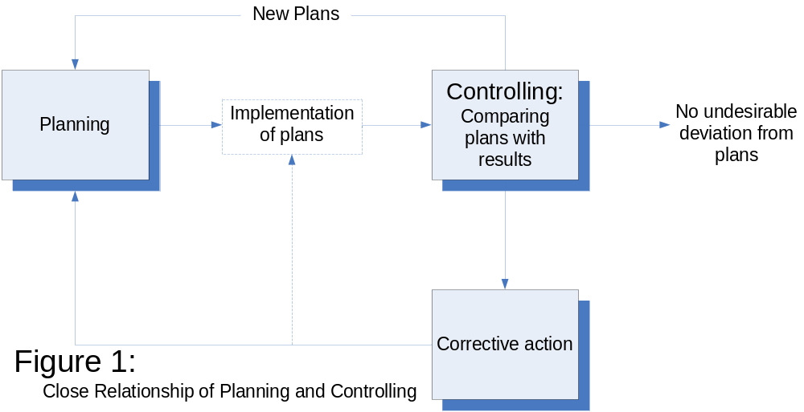
Close Relationship of
Planning and Controlling
Planning and Controlling are inseparable.
  They are the Siamese Twins of Management.

Slide 5
Close Relationship of
Planning and Controlling
Any attempt to control without plans is meaningless, since there is no way for people to tell whether they are going where they want to go (the result of the task of control) unless they first know where they want to go (part of the task of planning).
Plans thus furnish the standards of control.

Slide 6
Types of Plans
Visions
  A picture of the state of the desired outcome in the future usually in the long term from current time.
  It answers the question “where do we want to go?”
  It is a plan, a goal, an objective. It should be specific, measurable, attainable, realistic and time-bound.

Slide 7
Developing a Vision
Begins with thinking strategically
  About the firm’s future makeup;
  Forming vision of firm’s future in 5-10 years
  Task is to:
    - Inject sense of purpose into firm’s activities;
    - Provide LONG-TERM DIRECTION;
    - Give the firm STRONG IDENTITY;
    - Decide “WHO we are, WHAT we do, & WHERE we are - headed”

Slide 8
Types of Plans
2. Purposes and Missions
  Identifies the basic purpose or function or tasks of the organization or any part of it.
  In every social system, enterprises have a basic function or task assigned to them by society.
  For example, the purpose of a business generally is the production and distribution of goods and services.
  The purpose of a state highway department is the design, building, and operation of a system of state highways.
  The purpose of the courts is the interpretation of laws and their application.
  The purpose of a university is teaching, research, and providing services to the community.

Slide 9
Types of Plans
Goals or Objectives
  Represent not only the end point of planning, but also the end toward which organizing, directing/leading, and controlling are aimed.

Slide 10
TYPES OF OBJECTIVES NEEDED by an Organization:
Financial Objectives
Outcomes that relate to improving firm’s financial performance

Slide 11
SPECIFIC FINANCIAL CORPORATE OBJECTIVES
McCORMICK & COMPANY
Improve returns from each of our existing operating groups.
Achieve a 20% return on equity.
Achieve net sales growth rate of 10% per year.
Maintain an average earnings per share growth rate of 15% per year.

Slide 12
SPECIFIC FINANCIAL CORPORATE OBJECTIVES
QUAKER OATS COMPANY
To achieve return on equity at 20% or above, “real” earnings growth averaging 5% or better over time, be a leading marketer of strong consumer brands, and improve the profitability of low-return businesses or divest them.

Slide 13
TYPES OF OBJECTIVES NEEDED by an Organization:
Strategic Objectives
Outcomes that will result in greater competitiveness & stronger long-term market position

Slide 14
SPECIFIC STRATEGIC CORPORATE OBJECTIVES
NIKE
Protect & improve Nike’s position as the number one athletic brand in America.
Build a strong momentum in growing fitness market.
Intensify the company’s effort to develop products that customers need and want.

Slide 15
SPECIFIC STRATEGIC CORPORATE OBJECTIVES
ATLAS CORPORATION
To become a low-cost, medium-size gold producer, producing in excess of 125,000 ounces of gold a year and building gold reserves of 1,500,000

Slide 16
Types of Plans
Strategies
  It is defined as the determination of the basic long-term objectives of an enterprise and the adoption of courses of action and allocation of resources necessary to achieve these goals.

Slide 17
WHAT IS A “STRATEGY?”
Consists of competitive moves & business approaches to produce successful performance
Management’s “game plan” for:
  Running the business
  Strengthening firm’s competitive position
  Satisfying customers
  Achieving performance targets

Slide 18

A strategy without metrics is just a wish. And metrics that are not aligned with strategy are a waste of time.

Slide 19
THINKING STRATEGICALLY: THREE BIG STRATEGIC QUESTIONS
WHERE ARE WE NOW?
2. WHERE DO WE WANT TO GO?
3. HOW WILL WE GET THERE?

Slide 20
Types of Plans
Policies
  General statements or understandings that guide or channel thinking in decision making.
  They help decide issues before they become problems.
  Make it unnecessary to analyze the same situation every time it comes up, and
  Unify other plans, thus permitting other managers to delegate authority and still maintain control over what their subordinates do.

Slide 21
Sample - Attendance Policy: No-Fault Point System:
The goal of this attendance policy is to reward good attendance and eliminate people with poor attendance.
It uses a point system, and does not excuse or unexcuse absences.
Each absence = 1 point(no multi-day occurrences)
Each late in (tardy) or early out = 1/2 point
Each no-show for work = 2 points
Each return with no prior call = 1 point
Each absence-free quarter eliminates all points and rewards the employee with a day off with pay.
Each employee starts fresh, with no points, each year.
Disciplinary Action:
7 points = verbal warning
8 points = written warning
9 points = 3 day suspension
10 points = termination

Slide 22
Types of Plans
Procedures
  Plans that establish a chronological sequences of required actions. In handling future activities;
  Details of the exact manner in which certain activities must be accomplished.;
  An example illustrating the relationship between procedures and policies:
  Company policies may grant employees vacations; procedures established to implement this policy will provide for scheduling vacations to avoid disruptions of work, setting rates of vacation pay and methods for calculating them, maintaining records to ensure each employee of a vacation, and spelling out the means for applying for leave.

Slide 23
Types of Plans
Rules
  Spell out specific required actions or nonactions.
  Usually the simplest type of plan.
  The essence of rule is that it reflects a managerial decision that a certain action must – or must not – be taken.
  Rules are different from policies in that policies are meant to guide decision making by marking off areas in which managers can use their discretion, while rules allow no discretion in their application.

Slide 24
Types of Plans
Programs
  A complex of goal, policies, procedures, rules, task assignments, steps to be taken, resources to be employed, and other elements necessary to carry out a given course of action;
  They are ordinary supported by budgets.

Slide 25
Types of Plans
Budgets
  A statement of expected results expressed in numerical terms. It may be called a “quantified” plan. In fact, the financial operating budget is often called a “profit plan”.
  It may be expressed in financial terms: in terms of labor-hours, units of product, or machine-hours; or in any other numerically measurable terms.
  It may deal with operation, it may reflect capital outlays, or it may show cash flow.
  They are also control devices. However, making a budget is clearly planning. The budget is the fundamental planning instrument in many companies.
  The budget is necessary for control, but it cannot serve as a sensible standard of control unless it reflects plans.

Slide 26
Steps in Planning
Being Aware of Opportunities
  All managers should:
    Take at preliminary look at possible future opportunities and see them clearly and completely.
    Know where their company stands in the light of its strengths and weaknesses.
    Understand what problems it has to solve and why.
    Know what it can expect to gain.
  Planning requires a realistic diagnosis of the opportunity situation.

Slide 27
Steps in Planning
Establishing Objectives
  To be done for the long-term as well as for the short range.
  Objective specify the expected results and indicate the end points of what is to be done, where the primary emphasis is to be placed, and what is to be accomplished.
  Objectives must be SMART.

Slide 28
Steps in Planning
Developing Premises
  Establish, circulate, and obtain agreement to utilize critical planning premises such as forecasts, applicable basic policies, and existing company plans.
  Premises are assumptions about the environment in which the plan is to be carried out.

Slide 29
Steps in Planning
Determining Alternative Courses
  Search for and examine alternative courses of action, especially those not apparent.
  The more common problem is not finding alternatives but reducing the number of alternatives so that the most promising may be analyzed.
  Even with mathematical techniques and the computer, there is limit of the number of alternatives that can be thoroughly examined.

Slide 30
Steps in Planning
Evaluating Alternative Courses
  Evaluate the alternatives by weighing them in the light of premises and goals.

Slide 31
Steps in Planning
Selecting a Course
  This is the point at which the plan is adopted – the real point of decision making.
  Occasionally, an analysis and evaluation of alternative courses will disclose that two or more are advisable, and the manager may decide to follow several courses rather than the one best course.

Slide 32
Steps in Planning
Formulating Derivative Plans
  When a decision is made, planning is seldom complete, and a seventh step is indicated.
  Derivative or action plans are almost invariably required to support the basic plan.

Slide 33
Steps in Planning
Quantifying Plans by Budgeting
  Quantify decisions and plan by converting them into budgets.
  The overall budget of an enterprise represents the sum total of income and expenses, with resultant profit or surplus, and the budgets of major balance sheet items such as cash and capital expenditures.
  If done well, budgets become a means of adding various plans and set important standards against which planning progress can be measured.

Slide 34
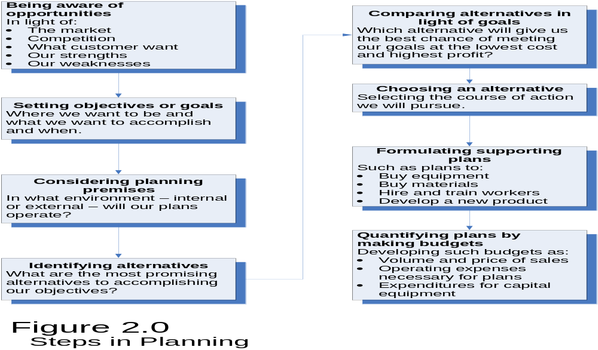
Steps in Planning

Slide 35
PLANNING TOOLS & TECHNIQUES
Gantt Charts
Pert-CPM Chart
Flow Process Charts
Cause & Effect Diagrams
Others

Slide 36
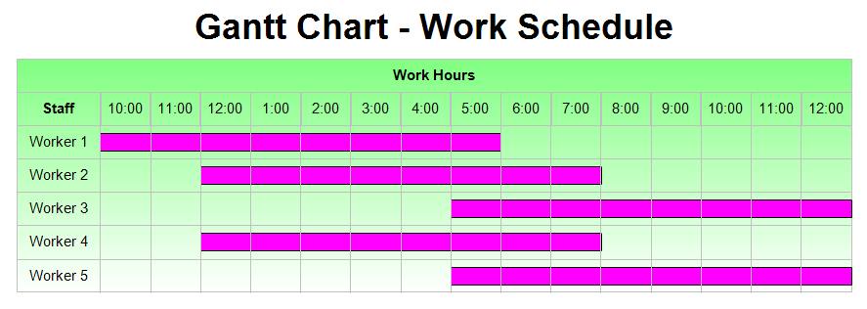
Gantt Chart – Work Schedule

Slide 37
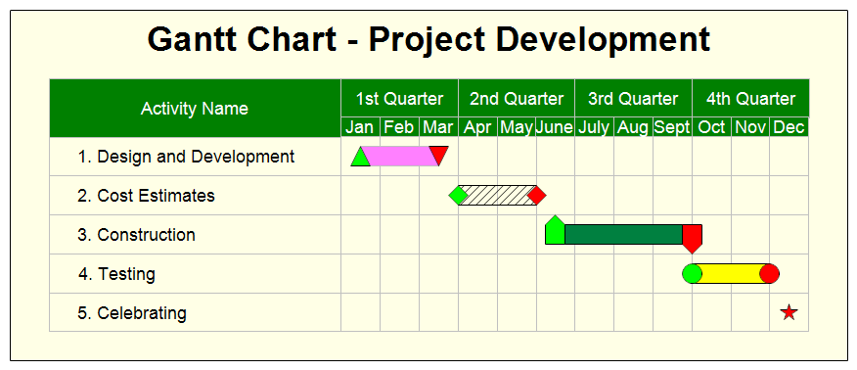
Gantt Chart – Project Development

Slide 38
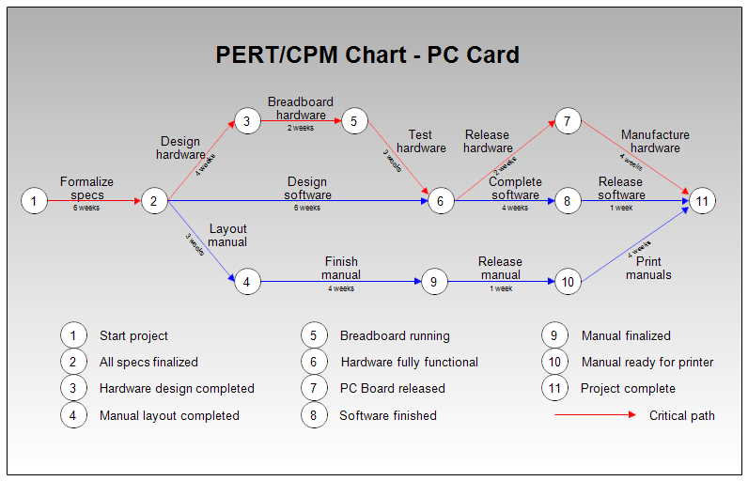
PERT/CPM Chart – PC Card

Slide 39
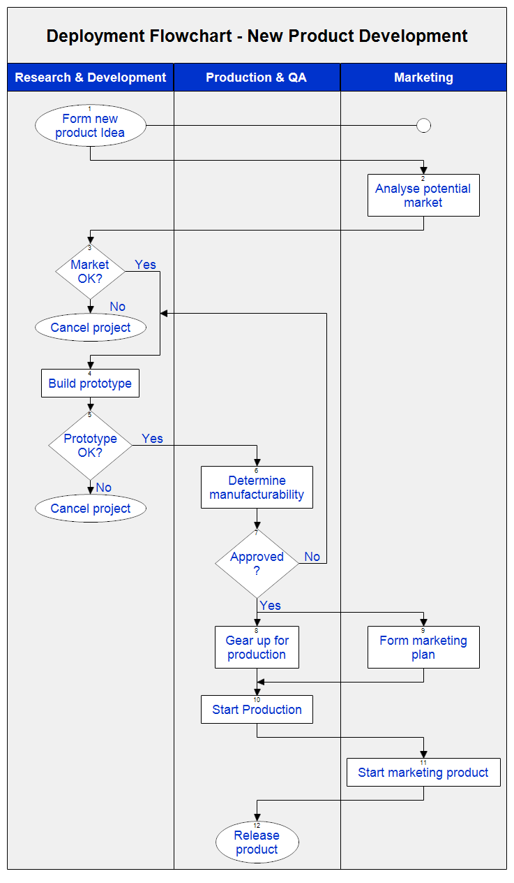
Deployment Flowchart
–
New Product Development

Slide 40
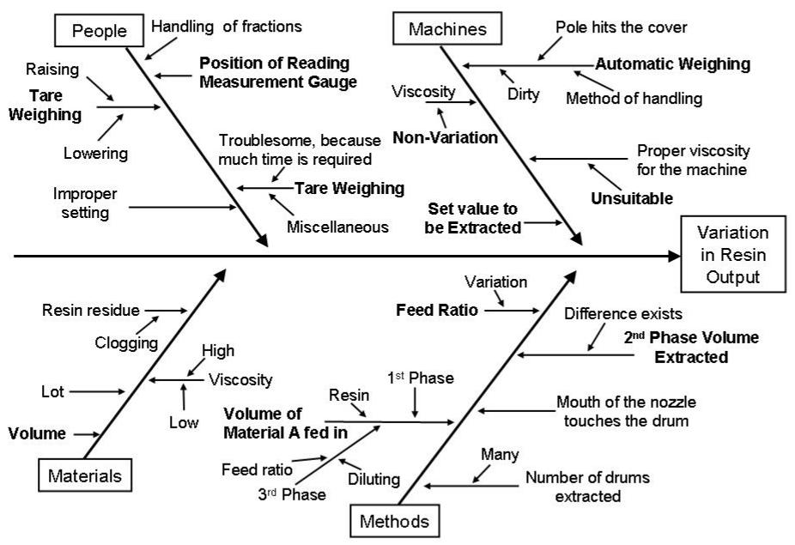
Cause & Effect Diagram

Slide 41
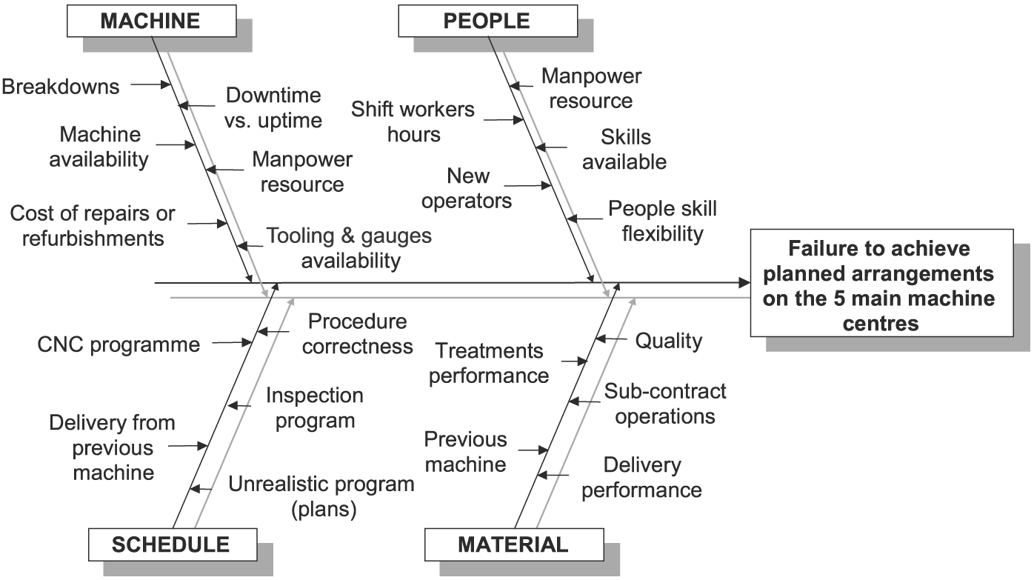
Cause & Effect Diagram

Slide 42
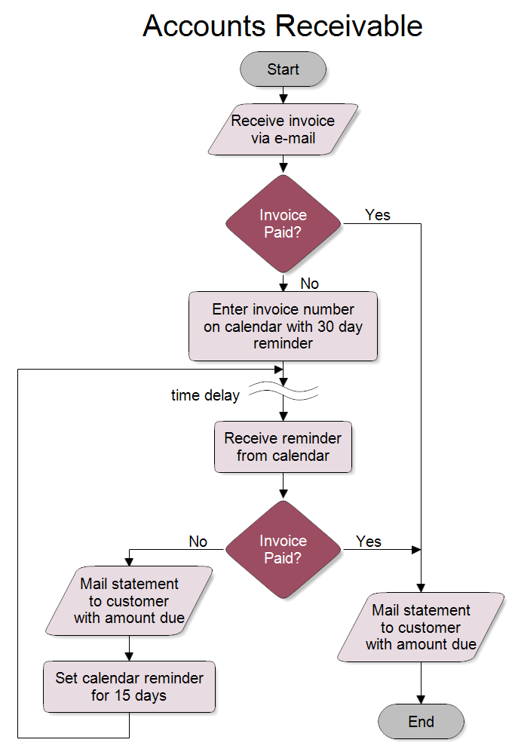
Process Mapping

Slide 43
The TOWS Matrix: A Modern Tool for Analysis of the Situation
The TOWS Matrix has been introduced for analyzing the competitive situation of the company that leads to the development of the four distinct sets of strategic alternatives.
The TOWS Matrix has a wider scope and a different emphasis from the business portfolio matrix and SWOT analysis.
The TOWS Matrix is a conceptual framework for a systematic analysis that facilitates matching of the external threats and opportunities with the internal weaknesses and strengths of the organization.

Slide 44
An Illustration: The Procter & Gamble Company Profile
The Procter & Gamble Company (P&G) boasts boatloads of brands. The world's #1 maker of household products courts market share and billion-dollar names. It's divided into three global units: health and well being, beauty, and household care. The company also makes pet food and water filters and produces a soap opera. Some two-dozen of P&G's brands are billion-dollar sellers, including Fusion, Always/Whisper, Braun, Bounty, Charmin, Crest, Downy/Lenor, Gillette, Iams, Olay, Pampers, Pantene, Pringles, Tide, and Wella, among others. P&G shed its coffee brands in late 2008. Being the acquisitive type, with Clairol and Wella as notable conquests, P&G's biggest buy in company history was Gillette in late 2005.

Slide 45
Procter & Gamble SWOT Analysis:
STRENGHTS New Management Gross Margin 15 Times the Industry Average One of the best marketers in the world Diversified brand portfolio: more than 300 brands with more than 79 billion in Revenue Tightly integrated with the largest retailers in the US and around the world Product innovation Talented management Distribute to 80 Countries Distribution channels all over the world New Billion Dollar brands | WEAKNESSESS Top Brands Losing Market Share Health and Beauty Women Only Lagging behind in online media presence & leadership Missing opportunity: Refuses to manufacture private label products for its retail customers Slow Process Heavy Culture Weak brands (Duracell, Iam, Braun, Pringles) Views Product Performance only
OPPORTUNITIES Health and Beauty for Men Doubling Environmental Goals for 2012 Adding Value for the Conspiracy Utilizing online social networks Going Green/Eco Friendly Capitalizing on online media Continue to divest brands that don't align with the company's long-term goals (i.e., Folgers) Emerging markets New acquisition opportunities Selling directly to consumers Design for better product experience | THREATS Substitute brands that have a cheaper price Private label growth Slowdown in consumer spending in the US & globally Key competitors expanding their product portfolios through acquisitions Increase in raw material price Commodity cost and currency exchange rate placed tremendous pressure on the business

Slide 46
The TOWS Matrix: A Modern Tool for Analysis of the Situation
Internal factors External factors | Internal strengths (S) e.g., strengths in management, operations, finance, marketing, research and development, engineering. | Internal weaknesses (W) e.g., weaknesses in areas shown in the “strengths” box.
External opportunities (O) (consider risks also) e.g., current and future economic conditions; political and social changes; new products, services, and technology. | SO strategy: Maxi-Maxi Potentially the most successful strategy, utilizing the organization’s strengths to take advantage of opportunities. | WO strategy: Mini-Maxi e.g., development strategy to overcome weaknesses in order to take advantage of opportunities.
External threats (T) e.g., energy shortage, competition, and areas similar to those shown in the “opportunities” box above. | ST strategy: Maxi-Mini Use of strengths to cope with threats or to avoid with threats. | WT strategy: Mini-Mini e.g., retrenchment, liquidation, or joint venture to minimize both weaknesses and threats.

Slide 47
Decision Making
It is defined as the selection of a course of action from among alternatives; it is at the core of planning.
A plan cannot be said to exist unless a decision–a commitment of resources, direction, or reputation–has been made.
Managers sometime see decision making as their central job because they must constantly choose what is to be done, who is to do it, and when, where, and occasionally even how it will be done.

Slide 48
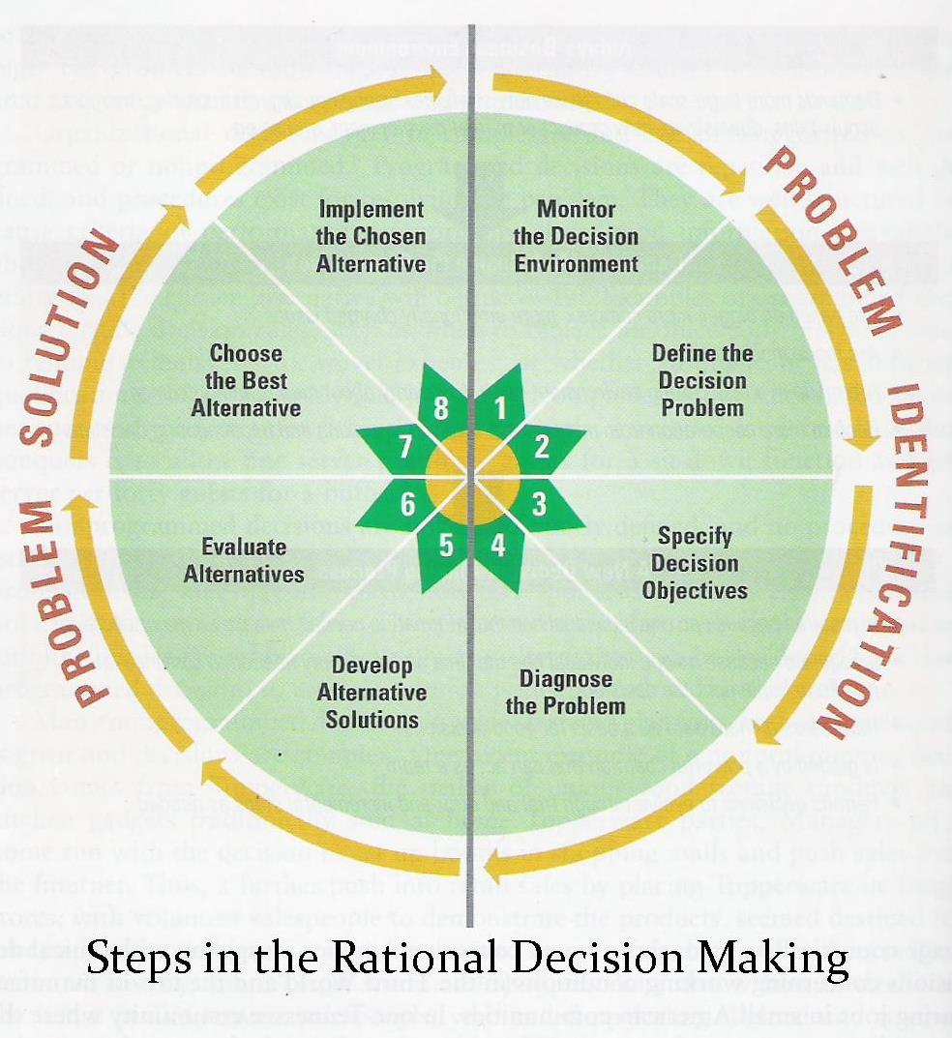

Slide 49
Major Steps in Decision Making
Identifying Alternatives and the Limiting Factor
  The ability to develop alternatives (by ingenuity, research, and common sense), is often as important as being able to select correctly among them.
  The manager needs help in this situation, as well as assistance in choosing the best alternative, is found in the concept of the limiting or strategic factor.
  A limiting factor is something that stands in the way of accomplishing a desired objective.
  The principle of the limiting factor states that, by recognizing and overcoming those factors that stand critically in the way of a goal, the best alternative course of action can be selected.

Slide 50
Steps in Decision Making
Evaluation of Alternatives
  This is the point of ultimate decision making, although decisions must also be made in the other steps of planning—in selecting goals, in choosing critical premises, and even in selecting alternatives.
  Because of complexities in evaluating alternatives, newer methodologies and applications and analysis are needed:
  Advantages/ Disadvantages
  Strengths/ Weaknesses
  Cost-Benefit Analysis (C.B.A.)
  Decision Trees

Slide 51
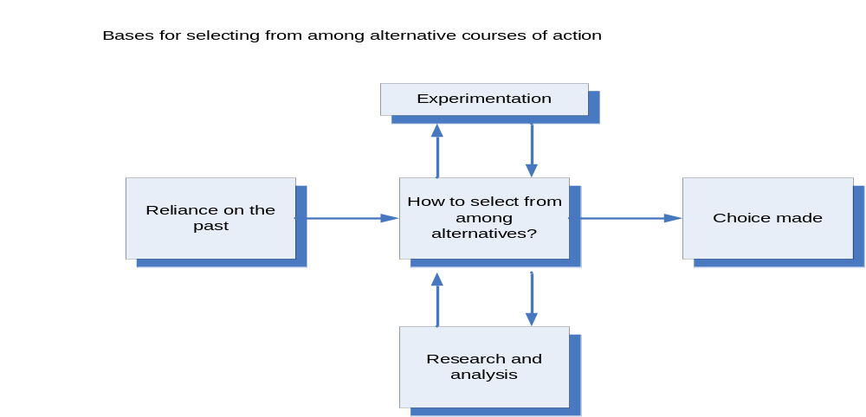
Steps in Decision Making
Selecting an Alternative: Three Approaches

Slide 52
Decision Making under Certainty, Uncertainty, and Risk
Certainty
  In a situation involving certainty, people are reasonably sure about what will happen when they make a decision. The information is reliable and is considered to be reliable, and the cause and effect relationships are known.
Uncertainty
  In a situation of uncertainty, on the other hand, people have only a meager database, they do not know whether or not the data are reliable, and they very unsure about whether or not the situation may change.
Risk
  In a situation with risks, factual information may exist, but it may be incomplete. To improve decision making, one may estimate the objective probability of an outcome by using, for example, mathematical models. On the other hand, subjective probability, based on judgment and experience, may be used.
Reference : Management - A Global Perspective by Weihrich and Koontz 11th Edition

